Slide 1
Quantum ensemble learning for classification with various quantum classifiers
SnuQuant
Jung, Jaewon

Slide 2
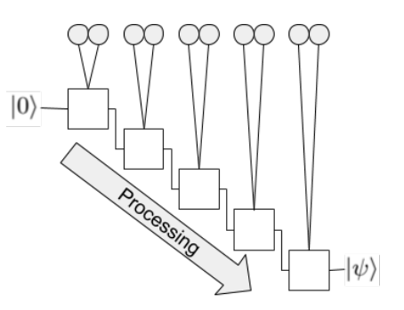
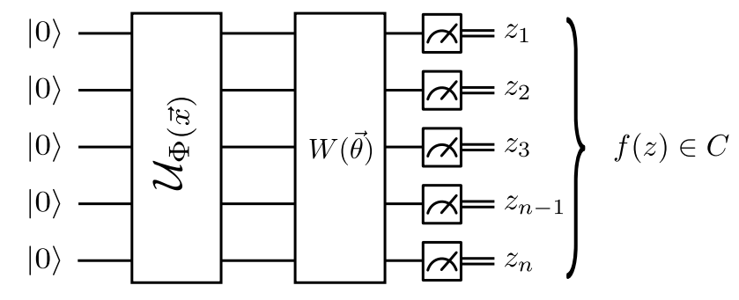
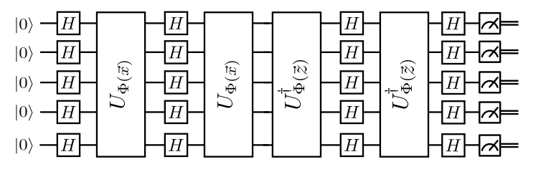
Quantum Classification Method
Supervised learning
- Quantum Support vector machine, Variational Quantum classifier, Data re-uploading method, QNN, QGANs….
Variational Quantum Classifier
Quantum Support vector machine
Data re-uploading method

Slide 3
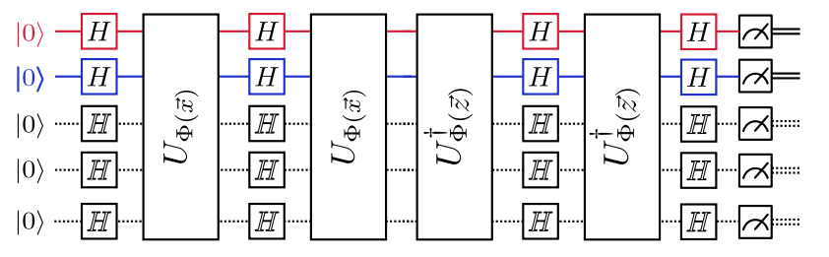
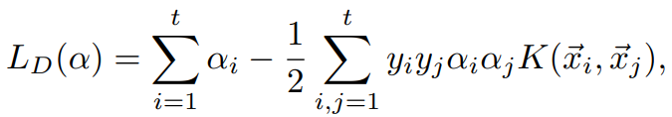
Quantum support vector machine
1. Obtain Quantum kernel from direct inner product by quantum circuit using feature map
2. minimize

Slide 4

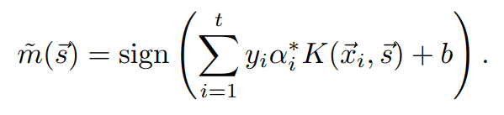
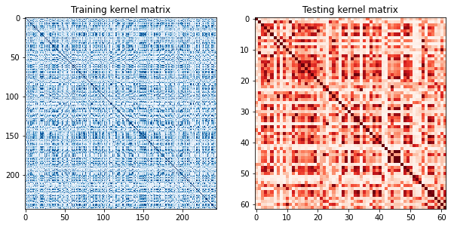
Quantum support vector machine
3. From optimized get classification result
Kernel from QSVM - statevector result
Training (left)
Test (right)

Slide 5
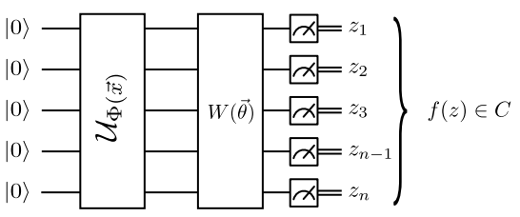
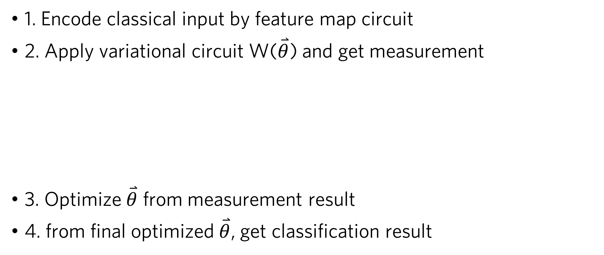
Variational quantum classifier
1. Encode classical input by feature map circuit
2. Apply variational circuit W($\overset{⃑}{θ}$) and get measurement
3. Optimize $\overset{⃑}{θ}$ from measurement result
4. from final optimized $\overset{⃑}{θ}$, get classification result

Slide 6
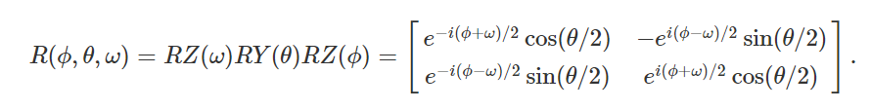
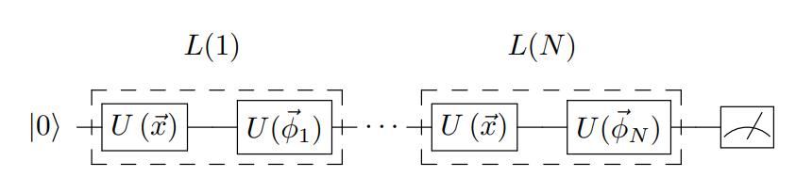
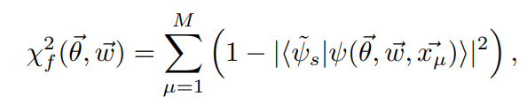
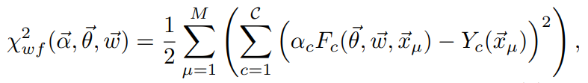
Data re-uploading method
Series of data encoding and single qubit operations based on universality of arbitrary single qubit rotation
Matrix form of arbitrary gate
Layers of encoding and
single qubit rotation
Fidelity cost function
Weighted fidelity cost function

Slide 7
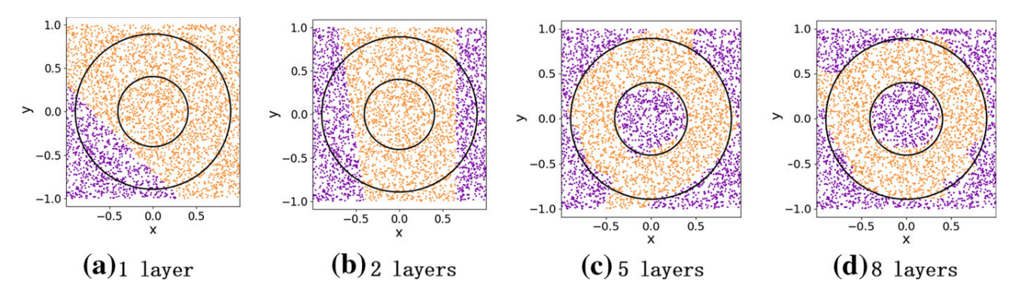
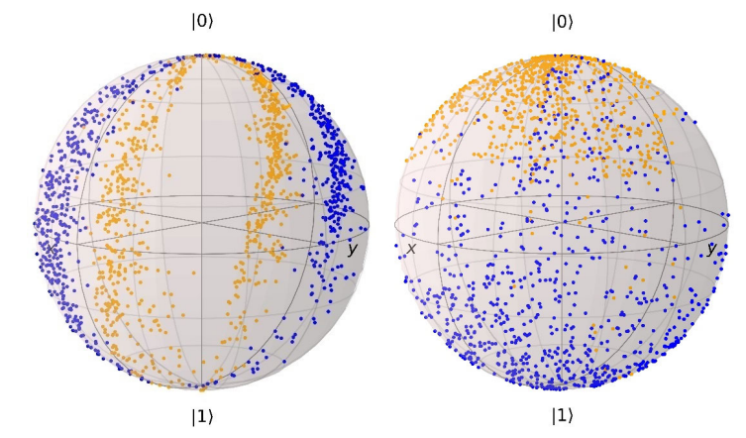
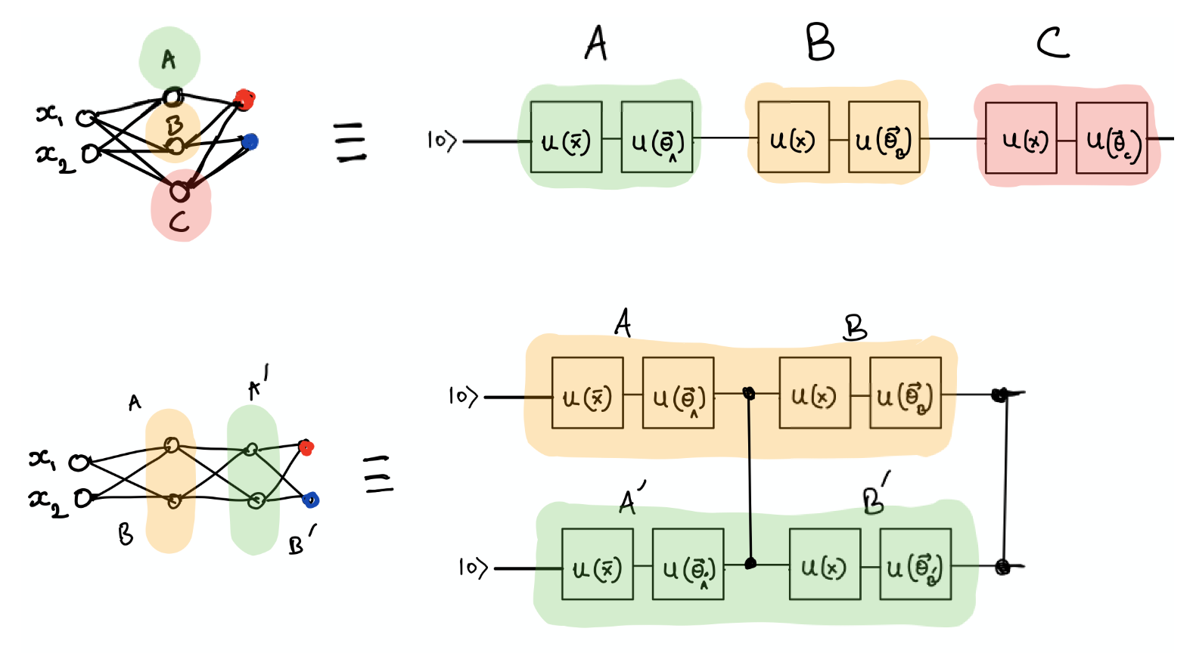
Data re-uploading method
Classification of synthetic data
Bloch sphere representation of data
Only need one qubit regardless of input feature #
-> Decreased # of qubits and gates
(Of course, we can utilize more qubits if needed)

Slide 8
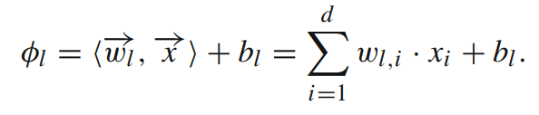

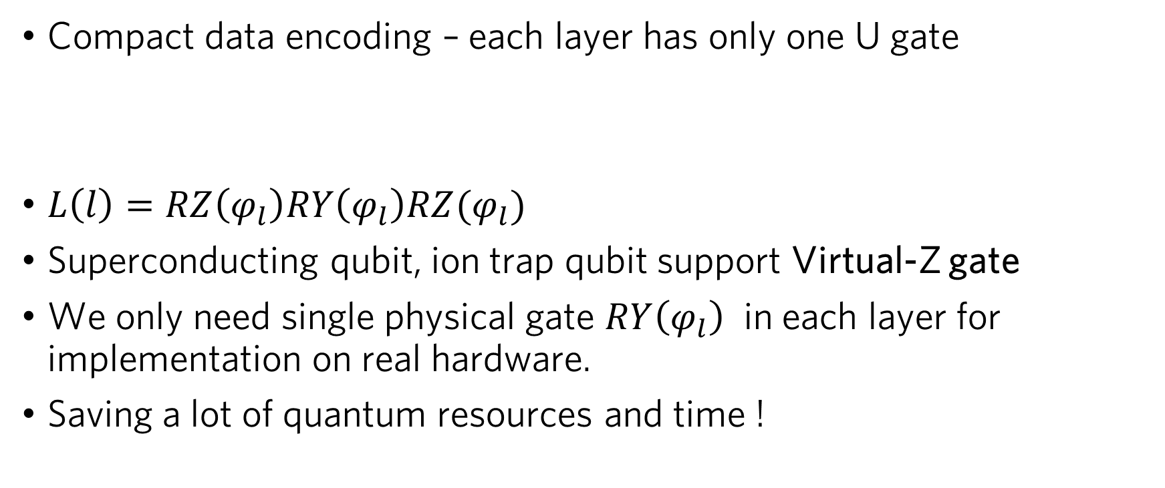
Data re-uploading method
Compact data encoding – each layer has only one U gate
$L\left(l\right)=RZ\left(φ_{l}\right)RY\left(φ_{l}\right)RZ(φ_{l})$
Superconducting qubit, ion trap qubit support Virtual-Z gate
We only need single physical gate $RY\left(φ_{l}\right)$ in each layer for implementation on real hardware.
Saving a lot of quantum resources and time !

Slide 9
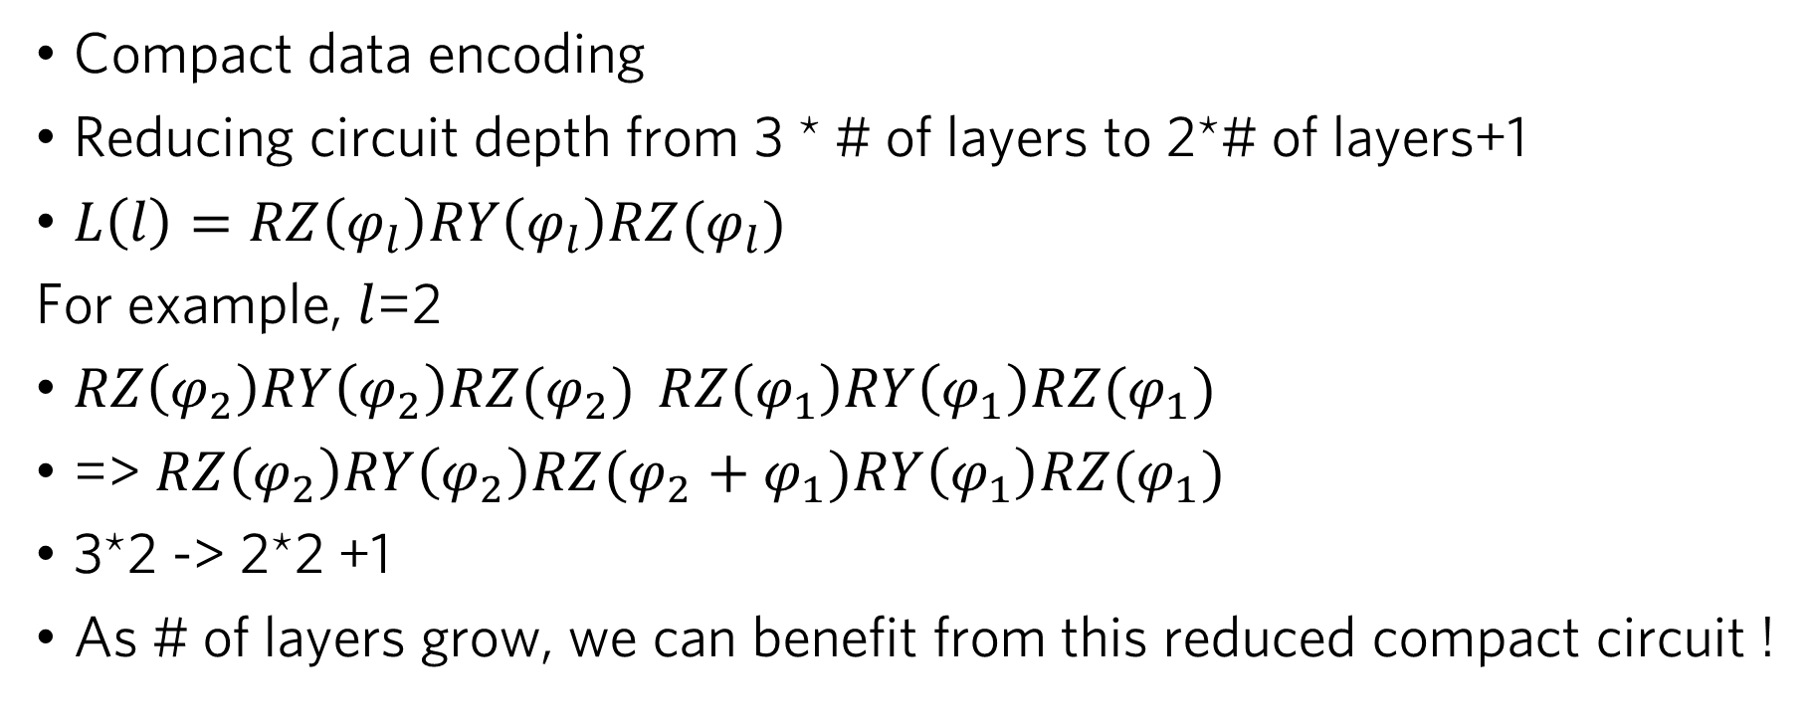
Data re-uploading method
Compact data encoding
Reducing circuit depth from 3 * # of layers to 2*# of layers+1
$L\left(l\right)=RZ\left(φ_{l}\right)RY\left(φ_{l}\right)RZ(φ_{l})$
For example, $l$=2
$RZ\left(φ_{2}\right)RY\left(φ_{2}\right)RZ(φ_{2})$ $RZ\left(φ_{1}\right)RY\left(φ_{1}\right)RZ(φ_{1})$
=> $RZ\left(φ_{2}\right)RY\left(φ_{2}\right)RZ(φ_{2}+φ_{1})RY\left(φ_{1}\right)RZ(φ_{1})$
3*2 -> 2*2 +1
As # of layers grow, we can benefit from this reduced compact circuit !

Slide 10
Dataset
In the dataset selection process, we had to compromise between compactness and difficulty of classification
Haberman’s Survival Dataset was selected
306 data points
Features
1. Age of patient at time of operation (numerical) 2. Patient's year of operation (year - 1900, numerical) 3. Number of positive axillary nodes detected (numerical)
Class : Survival status 1 = the patient survived 5 years or longer 2 = the patient died within 5 year

Slide 11
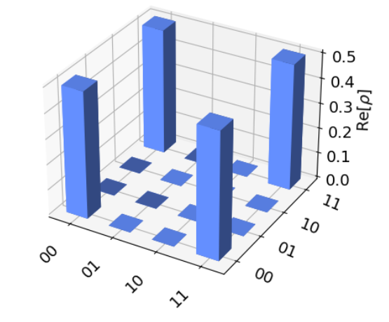

Quantum Ensemble learning with Quantum classifiers
If we know quantum state from classifiers,
We can also get benefit in Decision procedure.
We can use QST for ensemble vote also.
Classifier 1
Decision
procedure
Input data
Classifier 2
Prediction
⋮
⋮
Classifier n
Voting, Quantum state tomography…
Data re-uploading method, QSVM, …..
Maybe some classical classifiers for hybrid classification

Slide 12
Quantum Ensemble learning with Quantum classifiers
In decision procedure, we use
1. Simple averaging (y1+y2+….)
2. Weighted averaging (c1*y1+c2*y2+….)
And do the majority voting from above -> obtain y_hat

Slide 13
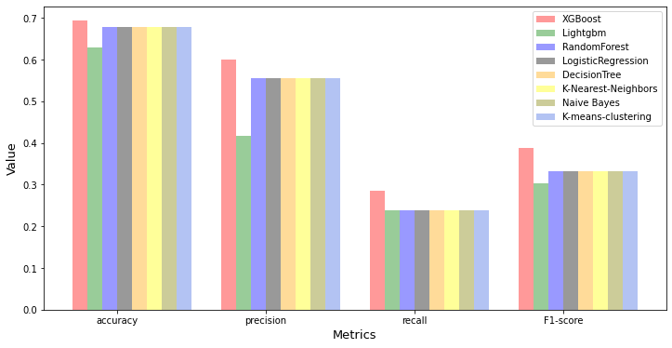
Results from Classical algorithms

Slide 14
Results from quantum classifiers - Statevector
QSVM
accuracy: 0.7258
precision : 0.7000
recall : 0.3333
F1-Score : 0.4516
We used ZZFeaturemap(reps=2) for both QSVM, VQC
And used RealAmplitude(reps=3) ansatz for VQC
VQC
accuracy: 0.6774
precision : 0.5385
recall : 0.3333
F1-Score : 0.4118
Simple averaging
accuracy: 0.6774
precision : 0.5217
recall : 0.5714
F1-Score : 0.5455
Weighted averaging
accuracy: 0.7258
precision : 0.7000
recall : 0.3333
F1-Score : 0.4516
Data re-uploading, 5 layers
With weighted fidelity(pennylane)
accuracy: 0.6935
precision : 0.5455
recall : 0.5714
F1-Score : 0.5581

Slide 15
Results from quantum classifiers - Simulator
VQC-ionq_simulator
accuracy: 0.6774
precision : 0.5294
recall : 0.4286
F1-Score : 0.4737
QSVM-ibm_Sherbrooke(aer)
accuracy: 0.6935
precision : 0.6000
recall : 0.2857
F1-Score : 0.3871
VQC-ibm_Sherbrooke(aer)
accuracy: 0.6774
precision : 0.5294
recall : 0.4286
F1-Score : 0.4737
Simple averaging
accuracy: 0.7097
precision : 0.6364
recall : 0.3333
F1-Score : 0.4375
QSVM-ionq_simulator
accuracy: 0.7097
precision : 0.6667
recall : 0.2857
F1-Score : 0.4000
VQC-ibm_Sherbrooke(aer)
Applied DD sequence
accuracy: 0.6935
precision : 0.7500
recall : 0.1429
F1-Score : 0.2400
Weighted averaging
accuracy: 0.7258
precision : 0.7000
recall : 0.3333
F1-Score : 0.4516

Slide 16
Dynamical Decoupling’s power check
These results are tested with ZZFeaturemap(reps=2), RealAmplitued(reps=5)
DD is applied on ansatz, we used long ansatz to see how DD is good for error mitigation
VQC-Statevector
accuracy: 0.7258
precision : 0.8333
recall : 0.2381
F1-Score : 0.3704
VQC-ibm_lima(aer) DD applied
accuracy: 0.7097
precision : 0.8000
recall : 0.1905
F1-Score : 0.3077
VQC-ibm_lima(aer) no DD
accuracy: 0.6452
precision : 0.0000
recall : 0.0000
F1-Score : 0.0000
For long ansatz, DD does matter!

Slide 17
Discussion
From results, ensemble of quantum classifiers outperformed classical algorithms. (Still, we have to consider that we didn’t hyper tune classical algorithms)
Nevertheless, it is shown that ensemble of quantum classifiers does have better classification result than single quantum classifiers.

Slide 18
Discussion
Also, in simulator results, weighted averaging method improved the result from simple averaging.
Surprising point is that even though each classifiers from simulator has worse performance than ones from statevector because of the presence of noise, when we did ensemble learning, classification power was same. Therefore, we can think that ensemble learning not only improves the classification result, it is also robust to noise at certain level.

Slide 19
Discussion
In Dynamical decoupling test, we can see that if the circuit is long enough to suffer noise, DD did mitigate errors.

Slide 20
Future works
In this project, we didn’t select feature map, ansatz carefully, but in fact, picking feature map and ansatz is very important problem in QML.
We have to pick and modify those circuits more elaborately.
Also, in data re-uploading method, we can implement pulse other than gate because all we need in hardware implementation is RY gate. Utilising pulse, we can reduce circuit duration a lot shorter. Therefore, we can use more layers on noisy hardware.

Slide 21
Future works
For checking hardware capabilities, we couldn’t see big difference between ionq_simulator and Ibm machine because of lack of testing.
In later works, we can test them with using more controlled gate and more long circuits to check what kind of advantages are best suit for quantum classifying algorithms.
All-to-all connectivity or good gate fidelity

Slide 22
References
Havlíček, Vojtěch, et al. "Supervised learning with quantum-enhanced feature spaces." Nature 567.7747 (2019): 209-212.
Schuld, Maria, and Francesco Petruccione. "Quantum ensembles of quantum classifiers." Scientific reports 8.1 (2018): 2772.
Pérez-Salinas, Adrián, et al. "Data re-uploading for a universal quantum classifier." Quantum 4 (2020): 226.
McKay, David C., et al. "Efficient Z gates for quantum computing." Physical Review A 96.2 (2017): 022330.
Dutta, Tarun, et al. "Single-qubit universal classifier implemented on an ion-trap quantum device." Physical Review A 106.1 (2022): 012411.
Fan, Liangliang, and Haozhen Situ. "Compact data encoding for data re-uploading quantum classifier." Quantum Information Processing 21.3 (2022): 87.
Qin, Ruiyang, et al. "Improving Quantum Classifier Performance in NISQ Computers by Voting Strategy from Ensemble Learning." arXiv preprint arXiv:2210.01656 (2022)

Slide 23

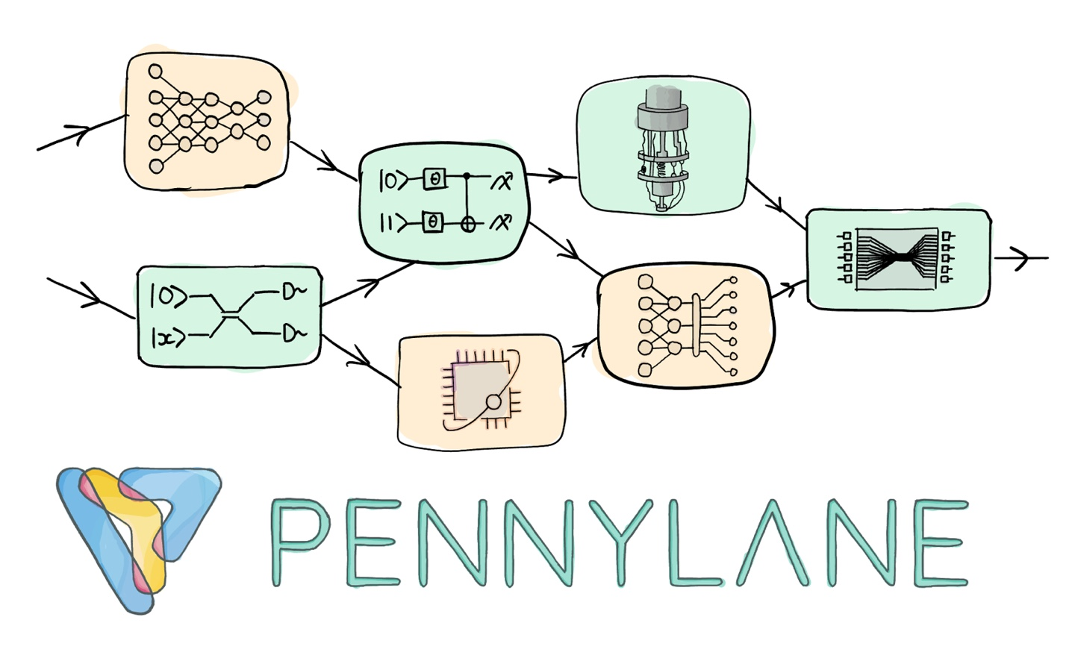

Thanks

